Slide 1
INTRODUCTION TO MARKETING
0
Chapter 3
The Cultural
Environment
NGUYEN THI PHUONG*
THANG LONG UNIVERSITY
*MA in Global Marketing, PHD in Economics

Slide 2
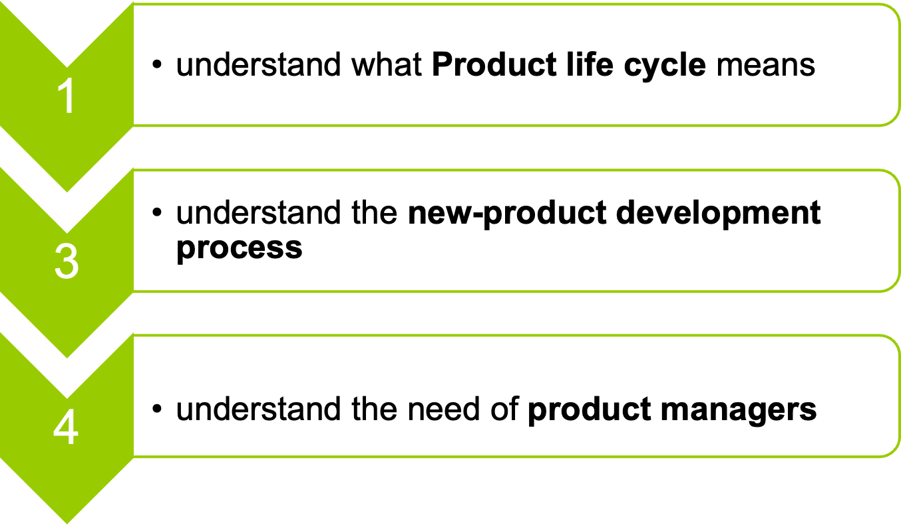
SESSION 9: Product development
Copyright © 2011 Pearson Education
15-<number>

Slide 3
9.1 Product life cycle
The product life cycle describes the stages a really new product idea goes through from beginning to end
Product life cycle is divided into four major stages (i) market introduction (ii) market growth (iii) market maturity and sales decline
Product life cycle is concerned with new types (or categories) of products in the market
Copyright © 2011 Pearson Education
15-<number>

Slide 4
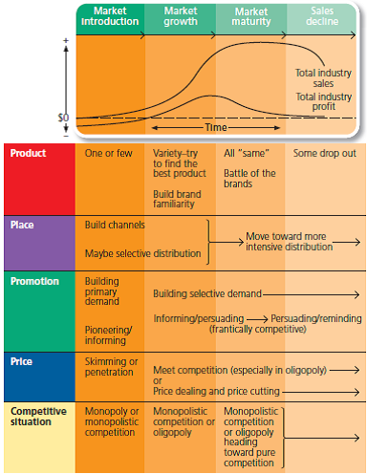
product life cycle
Copyright © 2011 Pearson Education
15-<number>

Slide 5
In the market introduction stages, sales are low as a new idea is first introduced to a market. Informative promotion is needed to tell potential customers
In the market growth stage, industry sales grow fast but industry profits rise and then start falling. The innovator begins to make big profits as more and more customers buy
In the market maturity: It is a time of rapid sales and earnings growth for companies with effective strategies. Competition get tougher and industry profits go down
Copyright © 2011 Pearson Education
15-<number>

Slide 6
In the sales decline, total sales decrease because of the appearance of new product. Profit maintains very low.
Question1: Competitor see the opportunity and enter the market by copying the most successful product or improving it to compete better which results in much product variety. When do these competitors enter the market?
Question 2: When do most companies use 4 Ps?
Copyright © 2011 Pearson Education
15-<number>

Slide 7
In a mature market, a firm may be fighting to keep or increase its market share. But if the firm finds a new use for the product, it may stimulate-overall demand
For example: iPhone, organic milk
Copyright © 2011 Pearson Education
15-<number>

Slide 8
9.2 New product development
It is essential for a firm to develop new products or modify its current products to meet changing customer needs
A product can become “new” in features, appeal, function. A fresh idea can be turned into a new product and start a new product life cycle.
A new product usually involves in R&D; production or market research of indiviual firm
Copyright © 2011 Pearson Education
15-<number>

Slide 9
Product development, also called new product management, is a series of steps that includes the conceptualization, design, development and marketing of newly created or newly rebranded goods or services.
The objective of product development is to cultivate, maintain and increase a company's market share by satisfying a consumer demand
Copyright © 2011 Pearson Education
15-<number>

Slide 10
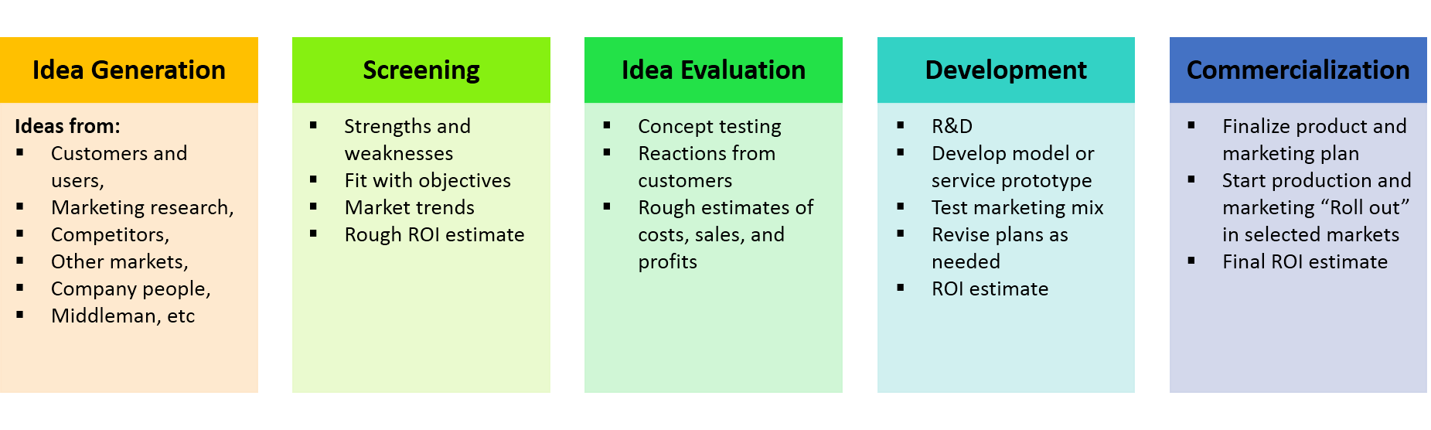
New product development process
Copyright © 2011 Pearson Education
15-<number>

Slide 11
Step 1: Idea generation
New ideas can come from a company’s own sales, production staff, middlemen competitors, consumer surveys, trade associations, advertising agencies, or government agencies.
Idea for new service can come directly from analysis of consumer complaints?
Step 2: Screening
Screening involves evaluating the new ideas with S.W.O.T analysis and product screening criteria
Copyright © 2011 Pearson Education
15-<number>

Slide 12
Step 3: Idea evaluation
When an idea moves past the screening step, it is evaluated more carefully
Firms use concept testing (focus groups, formal surveys) – getting reactions from customer about how well a new product idea fits their needs.
Copyright © 2011 Pearson Education
15-<number>

Slide 13
Step 4: Development
This involves some research and development (R&D)
Step 5: Commercialization
A product idea that survives this far can finally be placed on the market. Putting a product on the market is expensive, and success usually requires cooperation of the whole company.
Copyright © 2011 Pearson Education
15-<number>

Slide 14
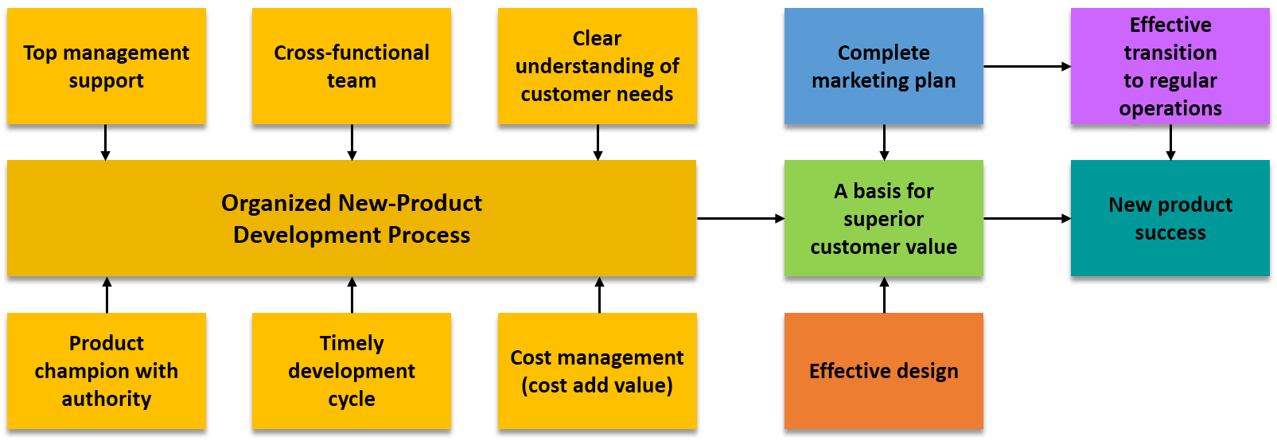
New product development
Copyright © 2011 Pearson Education
15-<number>

Slide 15
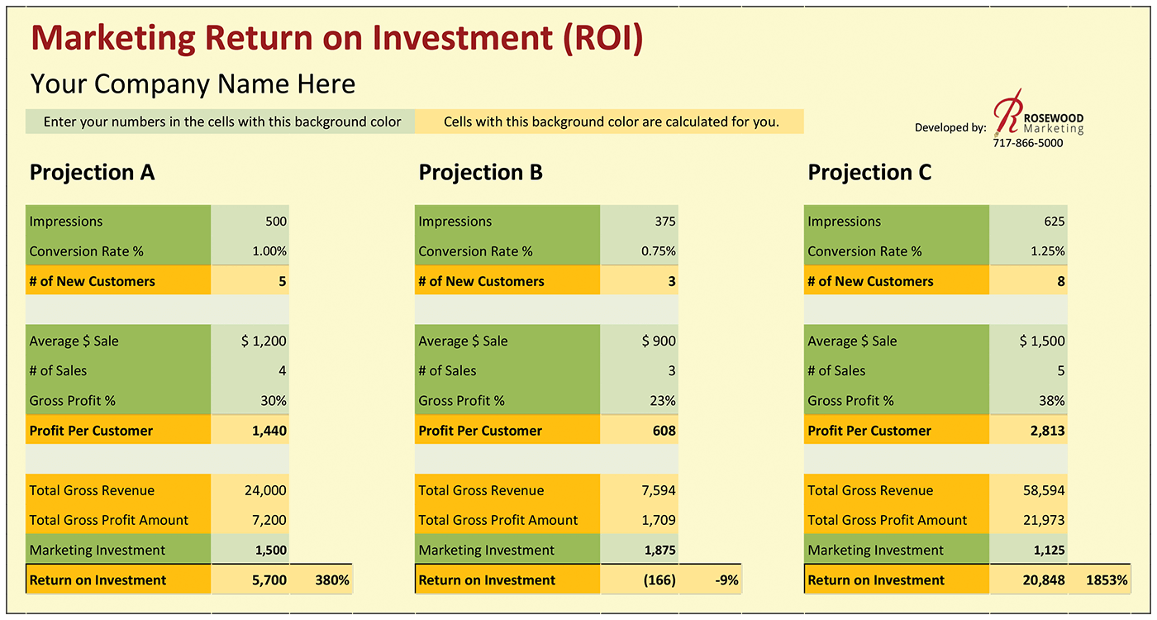
ROI estimation
Copyright © 2011 Pearson Education
15-<number>
Notes:
tỷ lệ lợi nhuận thu được so với chi phí bạn đầu tư
ROI = (Doanh thu – Chi phí)/Chi phí
MROI = (Tổng lợi nhuận – Chi phí MKT)/Chi phí MKT
No of customer = Impression* Conversion rate = 5000*1/100 = 5
Gross profit per customer=30%* Average sales = 0.3*1200*4=14000 (mỗi người mua 4 sản phẩm)
Conversion rate
Impression
Marketing Return of Investment= (7200-1500)/1500*1500*100%=380%

Slide 16
9.3 Need for product managers
when a firm has products in several different product categories, management may decide to put someone in charge of each category, or each brand
Product managers are especially common in large companies that produce many kinds of products.
These product managers are somtimes responsible for the profitable operation of a particular product’s whole marketing effort
Copyright © 2011 Pearson Education
15-<number>

Slide 17
Homework
1. What characteristics of a new product will help it to move through the early stages of the product life cycle more quickly? Briefly discuss each characteristic – illustrating with a product of your choice.
2 Explain the importance of an organized new product development process and illustrate how it might be used for (a) a new hair care product, (b) a new children’s toy, and (c) a new subscribers- only cable television channel.
Copyright © 2011 Pearson Education
15-<number>

